Slide 1
Capstone Engagement
Assessment, Analysis, and Hardening of a Vulnerable System

Slide 2
Table of Contents
This document contains the following sections:
01
Network Topology
02
Red Team: Security Assessment
03
Blue Team: Log Analysis and Attack Characterization
Hardening: Proposed Alarms and Mitigation Strategies
04

Slide 3
Network Topology
‹#›

Slide 4
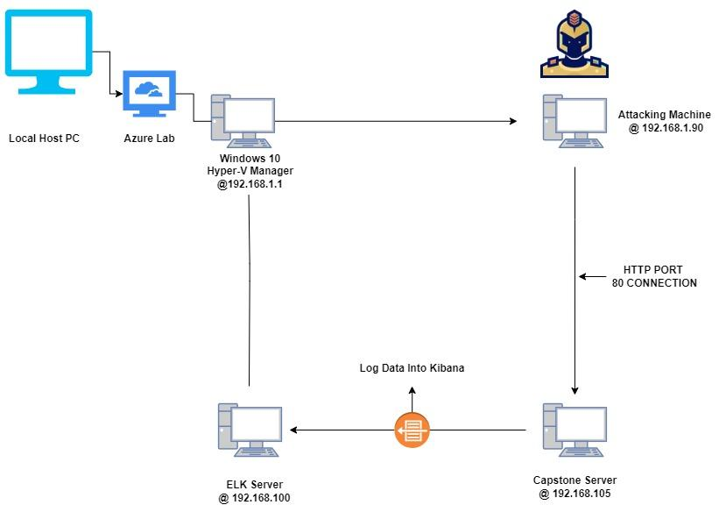
Network Topology
[Insert Here]
Use draw.io to create a diagram of the network.
Add your diagram to this slide and fill out the data in the sidebar.
Network
Address Range: 192.168.1.0/24
Netmask: 255.255.255.0
Gateway: 192.168.1.1
Machines
IPv4: 192.168.1.1
OS: WINDOWS 10
Hostname: Hyper-V
IPv4: 192.168.1.9
OS: KALI LINUX
Hostname: KALI LINUX
IPv4: 192.168.1.105
OS: LINUX
Hostname: CAPSTONE
IPv4: 192.168.1.1
OS: LINUX
Hostname: ELK SERVER

Slide 5

Red Team
Security Assessment
‹#›

Slide 6
Recon: Describing the Target
Nmap identified the following hosts on the network:
Hostname | IP Address | Role on Network
W10 Hyper-V Manager | 192.168.1.1 | The host machine used to conduct the pentest.
ELK Server | 192.168.1.100 | Elastic Search & Kibana server used to collect log information and activity on the Capstone server.
KALI LINUX VM | 192.168.1.90 | Attacking machine, used to find and exploit vulnerabilities on the Capstone Server.
Capstone Server | 192.168.1.105 | The server used to conduct the attack on.

Slide 7
Vulnerability Assessment
The assessment uncovered the following critical vulnerabilities in the target:
Vulnerability | Description | Impact
NIST CVE-2019-6579 | Port 80 was exposed to the internet, allowing for traffic to flow through. | Can run system commands using administrative authority
CVE-2020-14494 | Authentication mechanism within the system that does not provide sufficient complexity to protect against brute force attacks, which may allow unauthorized users to access the system after no more than a fixed maximum number of attempts | Vulnerability to Brute-Force attacks with no limit on attempts.
Insufficient password with insufficient cryptography | Hashed password was secured using md5sum hashing. | MD5 hashes are no longer considered cryptographically secure methods and should not be used for cryptographic authentication.

Slide 8
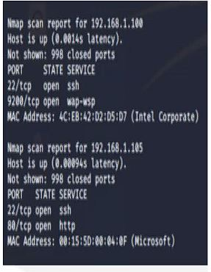
Exploitation: NIST CVE-2019-6579
01
02
03
Tools & Processes
Using Nmap 192.168.1.0/24 (subnet) to scan the accessible ports we could exploit
Achievements
Using this command allowed us to see accessible ports, 22/80 are open and we can exploit these.
Nmap Scan Conducted

Slide 9
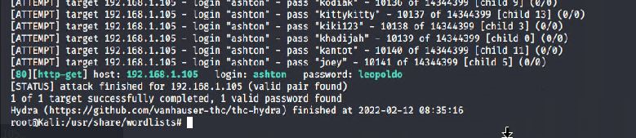
Exploitation: CVE-2020-14494
01
02
Achievements
Hydra allowed us to gain access to the “secret_folder” with ease. Lack of password complexity is abundant.
Tools & Processes
Once we gained access into the secret folder using Hydra to Brute-Force the password for Ashton we accessed the “secret_folder” where we seen a md5sum has exposed for Ryan's account which has access to the webdav.
03
Here we can see the results of the Brute-Force

Slide 10
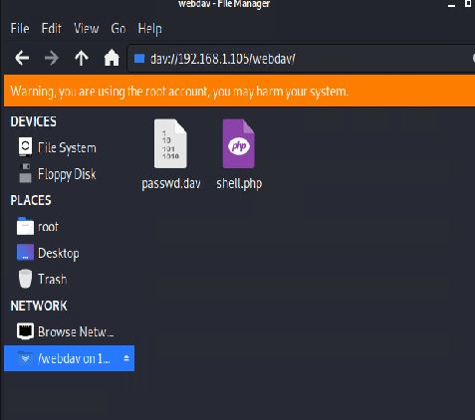
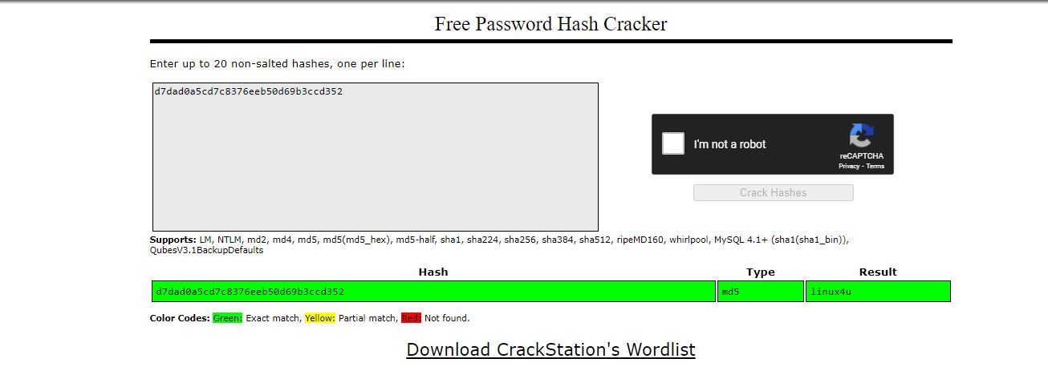
Exploitation: Insufficient password with insufficient cryptography
01
02
03
Tools & Processes
After gaining access to the “secret_folder” the Red Team was generously greeted with an md5sum hash under Ryan's account which is used to log into the webdav folder. This allowed us to inject a php script to gain C&C
Achievements
Using Crackstation to crack the hash, it gave us the password “linux4u” and allowed access to the webdav where we injected the shell.php script.
Access to the webdav folder using Ryan's credentials and injection of script.

Slide 11

Blue Team
Log Analysis and Attack Characterization
‹#›

Slide 12

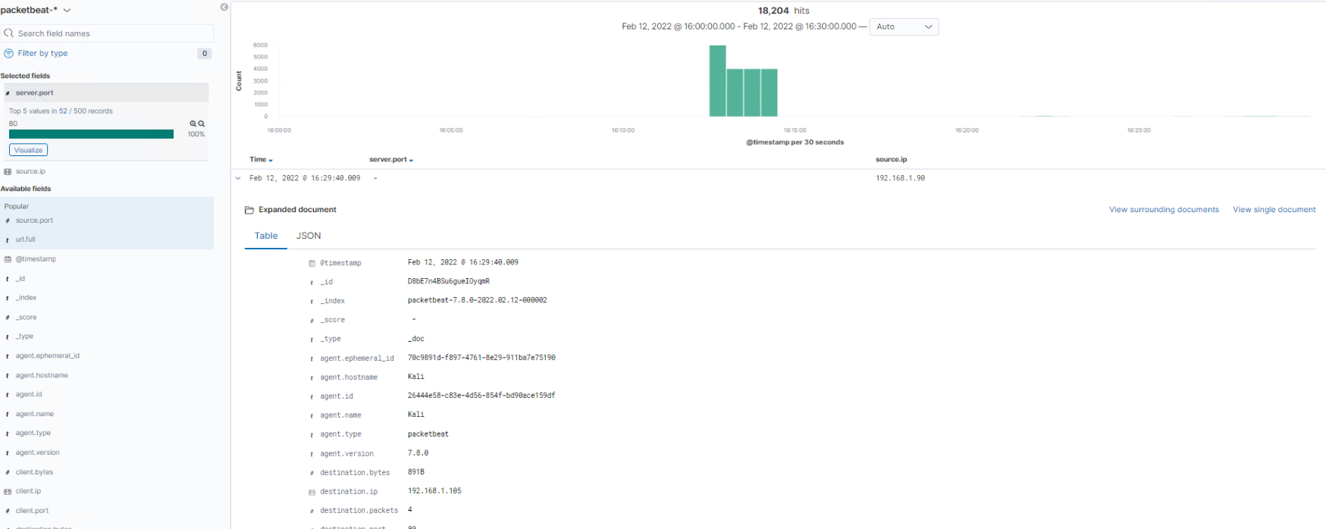
Analysis: Identifying the Port Scan
Port scan occurred at approximately 16:12:30 on Feb 12.
18,204 packets were sent from 192.168.1.90?
The numerous amount of requests for port 80 from 192.168.1.90
[Insert Here]
Include a screenshot of Kibana logs depicting the port scan.

Slide 13
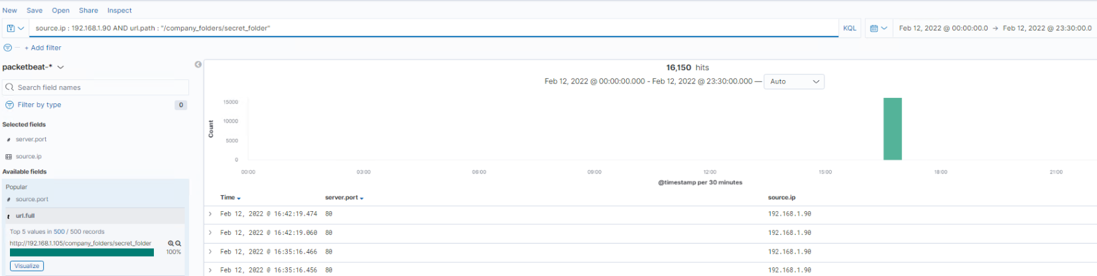
Analysis: Finding the Request for the Hidden Directory
The request came in at 16:30 with approximately 16150 requests.
Files requested were the secret_folder directory which contain a set of instructions to access the shared webdav account. (Which was seen after the brute-force was able to gain entry to the webdav folder)
[Insert Here]
Include a screenshot of Kibana logs depicting the request for the hidden directory.

Slide 14
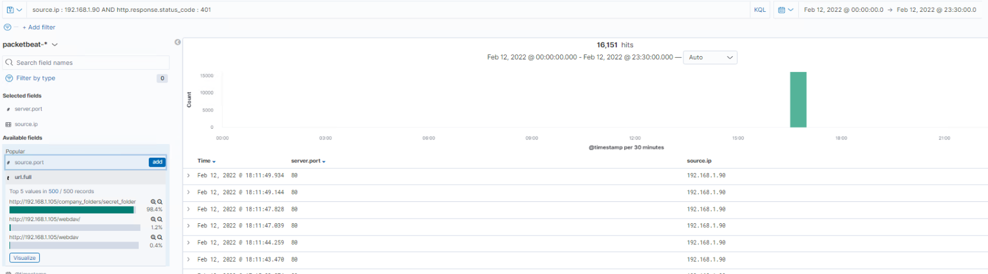
Analysis: Uncovering the Brute Force Attack
There were 16,141 requests made to login at approximately 16:30 on February 12.
The attacker was able to gain entry to Ashton's account after the 16,142nd attempt. Successfully gained account access.
[Insert Here]
Include a screenshot of Kibana logs depicting the brute force attack.

Slide 15
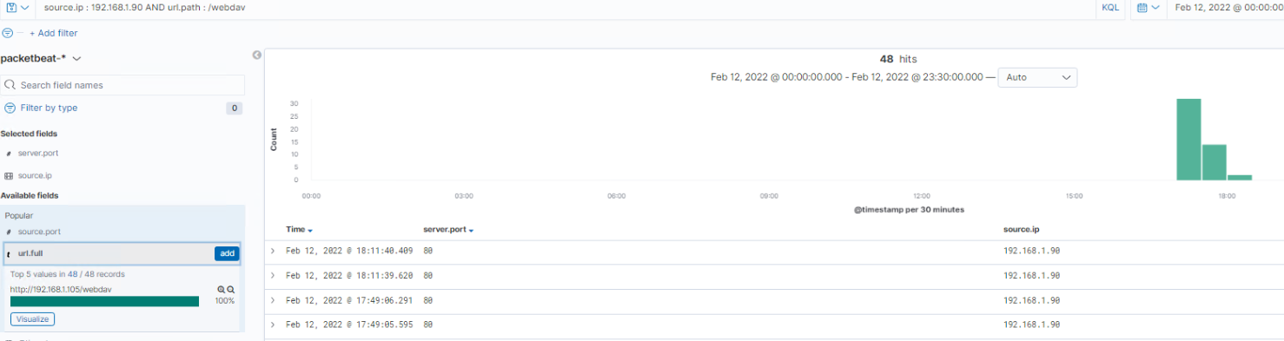
Analysis: Finding the WebDAV Connection
First request came in at 17:00 ending at 18:30 with approximately 48 requests.
Files requested were the webdav folder which contain a set of extensions to the HTTP protocol which allows users to collaboratively edit and manage files on remote web servers.
[Insert Here]
Add a screenshot of Kibana logs depicting the WebDAV connection.

Slide 16
Blue Team
Proposed Alarms and Mitigation Strategies
‹#›

Slide 17
Mitigation: Blocking the Port Scan
What kind of alarm can be set to detect future port scans?
If there was an overwhelming number of requests for ports coming from a single source IP
What threshold would you set to activate this alarm?
A threshold of 0 should apply. If there is any notice of this alarm triggering. It should notify immediately.
What configurations can be set on the host to mitigate port scans?
Installation of a firewall. A firewall can help stop unauthorized access.
An internal port scan should be completed as well to see if there are more ports than necessary exposed to the public. If so, close all unnecessary ports and place alarms on all others

Slide 18
Mitigation: Finding the Request for the Hidden Directory
What kind of alarm can be set to detect future unauthorized access?
A alarm should be triggered if anyone tries to access this hidden directory. Although a nuisance, security must be activley practiced.
What threshold would you set to activate this alarm?
A threshold of 0. Access should be two factor, with a secondary override to needed.
What configuration can be set on the host to block unwanted access?
The immediate removal of all secret and confidential company directories from the public facing webserver.
Describe the solution. If possible, provide required command lines.
If folders are needed; cp -R <source_folder> <destination_folder> then rmdir -r to perminately delete the directory

Slide 19
Mitigation: Preventing Brute Force Attacks
What kind of alarm can be set to detect future brute force attacks?
Lock out an IP address with multiple failed logins in succession.
Alert after 5 status code 401’s within a minute
What threshold would you set to activate this alarm?
There could be varying levels of this alarm. One alarm could be; alert after 10 unsuccsessful logins over an hour (or average based on average logins per hour)
What configuration can be set on the host to block brute force attacks?
Use of strong and complex passwords
Two - Factor Authenication
Use of CAPTCHA on logins
Lockout accounts after sequential failed logins
Describe the solution. If possible, provide the required command line(s).
These can be completed within the group policy settings in the server manager

Slide 20
Mitigation: Detecting the WebDAV Connection
What kind of alarm can be set to detect future access to this directory?
Any IP outside of the whitelisted IP’s should be alerted to the security center.
What threshold would you set to activate this alarm?
A threshold of 0, any bad access attempt outside of the “safe zone” should set the alert off.
What configuration can be set on the host to control access?
The only access point to the webdav folder should be within whitelisted IP’s, using complex passwords and hashing.
Describe the solution. If possible, provide the required command line(s).
Since the red team gained access via port 80, consider blocking that port.

Slide 21
Mitigation: Identifying Reverse Shell Uploads
What kind of alarm can be set to detect future file uploads?
An alarm that detects any “php” uploads
What threshold would you set to activate this alarm?
A threshold of 0. Any upload would need in depth investigation.
What configuration can be set on the host to block file uploads?
Adjust account settings so users can not write and to directories over HTTP. Use secondary authority at the user level to verify uploads to the directory.
Describe the solution. If possible, provide the required command line.
At a high level, block all upload capabilites for users. If uploads need to be done, they should be done at a local source level.

